Slide 1
Advanced N-mixture Models

Slide 2
Distributions for N
Poisson Distribution is common for count data but other distributions available
Zero-inflated Poisson
Negative Binomial

Slide 3

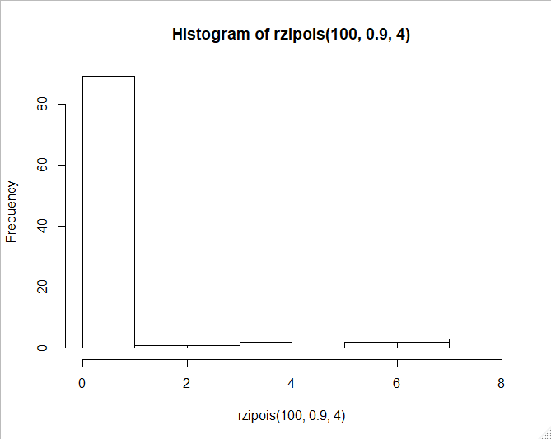
Zero-Inflated Poisson
Another layer added to hierarchical model
1st layer now accounts for extra 0s in dataset
Can be thought of as “suitability” of habitat/site
2nd layer typical Poisson distribution

Slide 4
Negative Binomial
Overdispersion
Variance large relative to the mean
Negative Binomial has 2 parameters to model giving it more flexibility
Some indications that may not produce valid results in unmarked

Slide 5
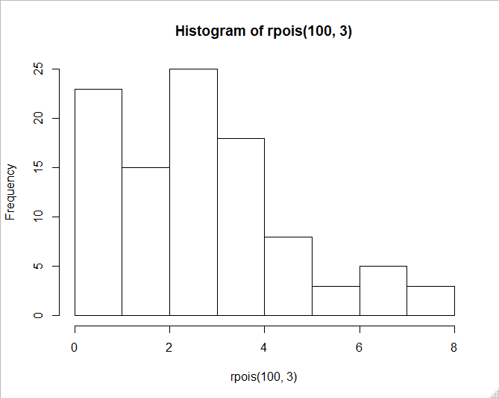
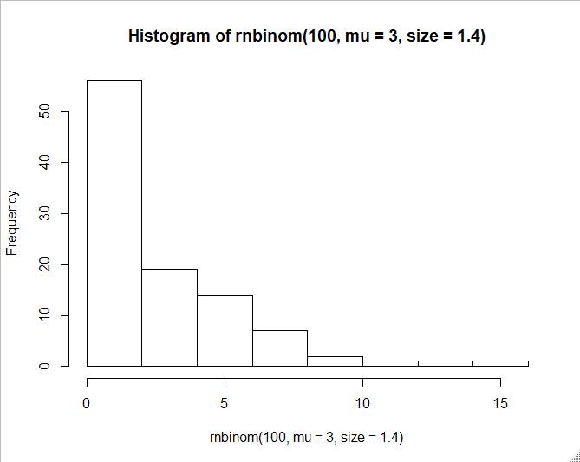
Poisson vs. Negative Binomial

Slide 6
Goodness-of-Fit Statistics
Test of how well the data fit your model
R function uses Pearson’s chi-square test and bootstrapping
Null hypothesis is that data fit, so “fits” if p > 0.05

Slide 7
Model Selection
Can compare models using AIC
Can compare both different covariates of interest as well as distributions (Poisson vs. zero-inflated Poisson)

Slide 8
Different Types of Survey Data
Removal data
Double observers
Open N-mixture models

Slide 9



Different Types of Survey Data
Removal data
For birds, only counting new birds heard during point count
Min 1-3
Min 4-6
Min 7-9
Min 9-11

Slide 10
Different Types of Survey Data
Removal data
For birds, only counting new birds heard during point count
Min 1-3
Min 4-6
Min 7-9
Min 9-11
Encounter history: 2010

Slide 11
Multinomial Detection Probabilities
Observation model is multinomial for removal sampling
We instead of removal frequencies for each sampling period
π₁ = p
π₂ = (1-p)p
π₃ = (1-p)²p
π₄ = (1-p)³p

Slide 12
Multinomial Detection Probabilities
Double observer sampling also uses multinomial probabilities

Slide 13
Random Effects in N-mixture Models
We can include random effects in N-mixture models as well
Could be for detection probability or abundance
Can be done in ‘unmarked’ or package ‘ubms’

Slide 14
Package ubms
ubms uses Bayesian statistics to calculate N-mixture models
Runs STAN in the background through R
Different notation from unmarked but similar to GLMM and lmer code

